Slide 1
Leading with Care
Bob DeKoch and Phillip G. Clampitt, long-time collaborators drawing on decades of experience, deliver a key leadership message for our challenging times.
1

Slide 2
Agenda
Degrees of caring
Why “Lead with Care”?
Who should be in this training?
Why should you believe the authors?
What can you expect?
2
leadingwithcare.net

Slide 3
1. Degrees of caring
Shallow caring
Deep caring
3
leadingwithcare.net

Slide 4
2. Why “lead with care”?
Employees lack engagement in their workplace
Gallup reported that only 15% of employees in the United States are truly engaged in the workplace
Citizens lack trust in public sector leaders
The workplace in a post-COVID world will be reimagined
54% of office workers say they’d leave for a job with more flexibility
4
leadingwithcare.net

Slide 5
2. Why “lead with care”? (cont’d)
Heightened political activism by employees has paralyzed many leaders
The sentiments behind “servant leadership” and “emotional intelligence” has proven to be a daunting challenge
5
leadingwithcare.net

Slide 6
3. Who should be in this training?
Aspiring leaders
Practicing leaders
Seasoned executives (leader of leaders)
6
leadingwithcare.net

Slide 7
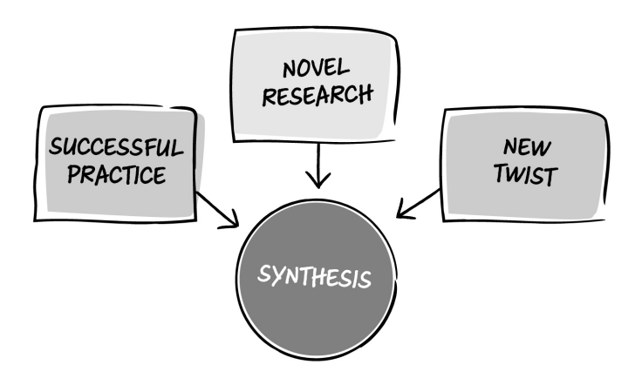
4. Why should you believe the authors?
7
leadingwithcare.net

Slide 8
5. What can you expect? (part 1)
Part 1: Core beliefs
Embracing uncertainty promotes growth
Progress-making inspires extraordinary performance
Cultivating the right values builds a special sense of identity
Life-long learning fosters humility
Acting with kindness is not being soft
8
leadingwithcare.net

Slide 9
5. What can you expect? (part 2)
Part 2: Practices
Visible Practices
Subtle Practices
9
leadingwithcare.net

Slide 10
Visit the website
LeadingWithCare.Net
Self-Tests (check your understanding)
Discussions Questions (expand your knowledge)
Self-Assessments (create a personal development plan)
10
leadingwithcare.net

Slide 11
“
An island of innovative insight among
an ocean of leadership BS.
- Professor James Barker
Herbert S. Lamb Chair in Business Education | Dalhousie University
11

